Slide 1



01-Amazon Global Superstore Project
View in Power BI
Last data refresh:
11-07-2024 15:54:28 UTC
Downloaded at:
11-07-2024 16:03:42 UTC

Slide 2
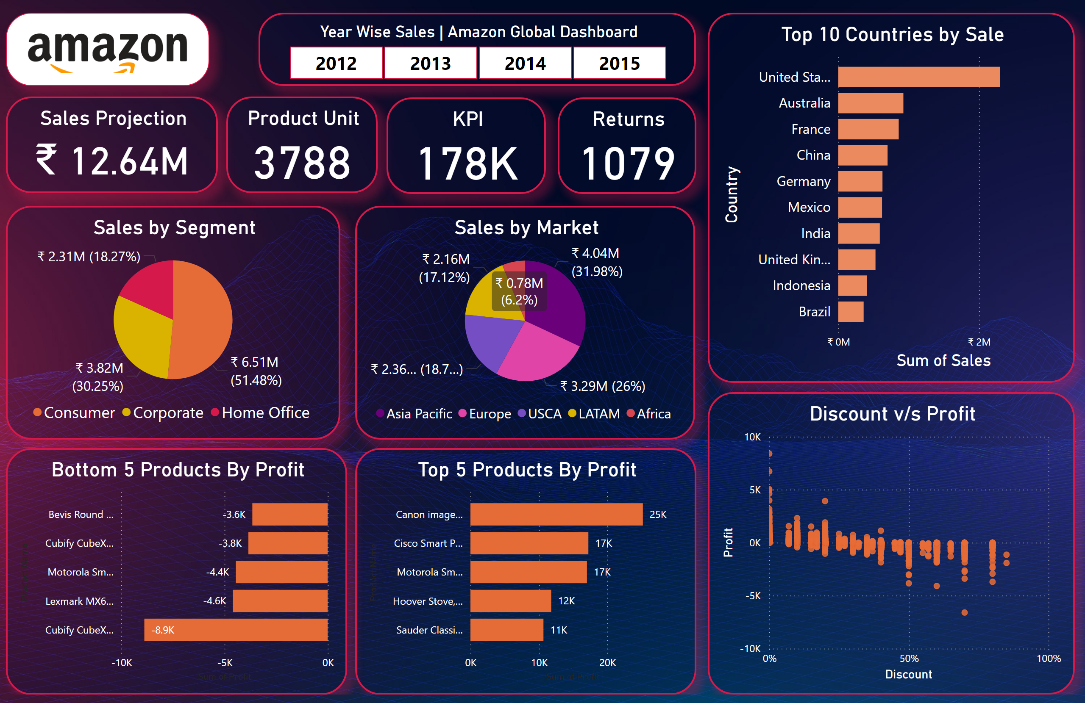
Page 1
Notes:
Year Wise Sales | Amazon Global Dashboard
No alt text provided
image
No alt text provided
Sales Projection
No alt text provided
Product Unit
No alt text provided
KPI
No alt text provided
Returns
No alt text provided
Sales by Segment
No alt text provided
Sales by Market
No alt text provided
Top 5 Products By Profit
No alt text provided
Discount v/s Profit
No alt text provided
Bottom 5 Products By Profit
No alt text provided
Top 10 Countries by Sale
No alt text provided

